Slide 1
Lecture 9 Reinforcement Learning
CS582
Machine Learning: Getting Computers
to Program Themselves
“Discovering the Learning Dynamics of the Laws of Nature”
Dr. Emdad Khan
ekhan@mum.edu
Dept. of Computer Science
Maharishi University of Management
May, 2018

Slide 2
Reinforcement Learning
Reinforcement learning fills the gap between supervised learning and unsupervised learning.
Reinforcement learning, the middle ground is where information is provided about whether or not the answer is correct, but not how to improve it. It is closely related to Biological Learning.
The reinforcement learner has to try out different strategies and see which work best.
That ‘trying out’ of different strategies is just another way of describing search that we have covered.

Slide 3
Reinforcement Learning
Search is a fundamental part of any reinforcement learner: the algorithm searches over the state space of possible inputs and outputs in order to try to maximize a reward.
Reinforcement learning is usually described in terms of the interaction between some agent and its environment.
The agent is the thing that is learning, and the environment is where it is learning, and what it is learning about.
The environment has another task, which is to provide information about how good a strategy is, through some reward function.

Slide 4
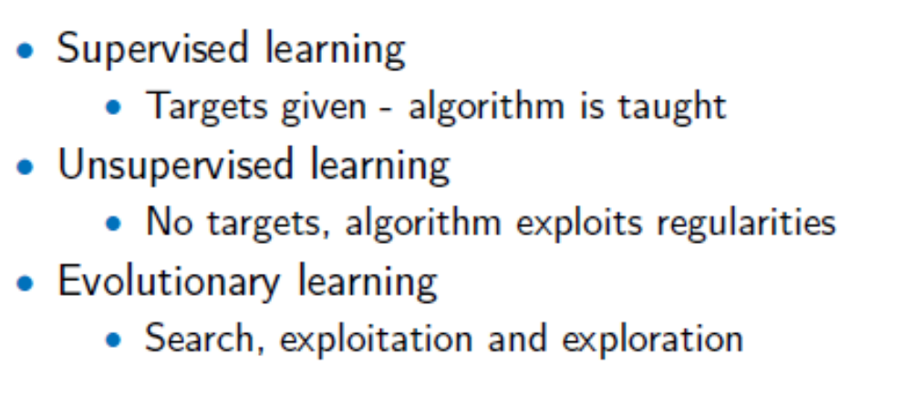
Quick Summary
So far we have covered the following:

Slide 5
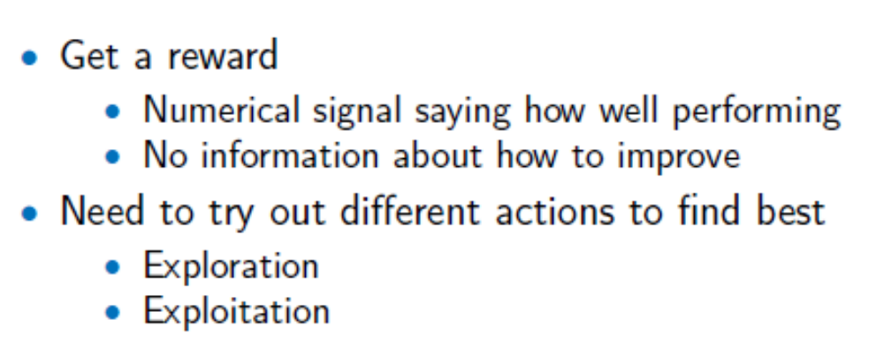
Reinforcement Learning

Slide 6
Reinforcement learning
Task
  Learn how to behave successfully to achieve a goal while interacting with an external environment
  Learn via experiences!
Examples
  Game playing: player knows whether it win or lose, but not know how to move at each step
  Control: a traffic system can measure the delay of cars, but not know how to decrease it.

Slide 7
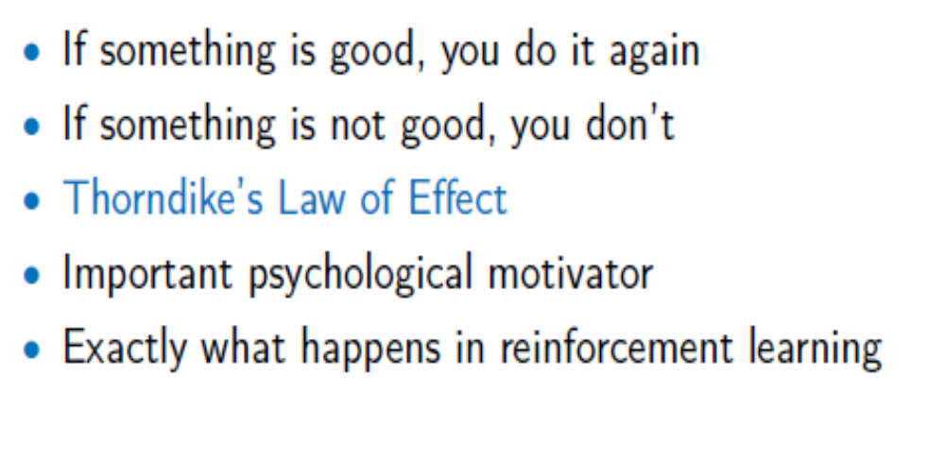
Psychological Motivation

Slide 8
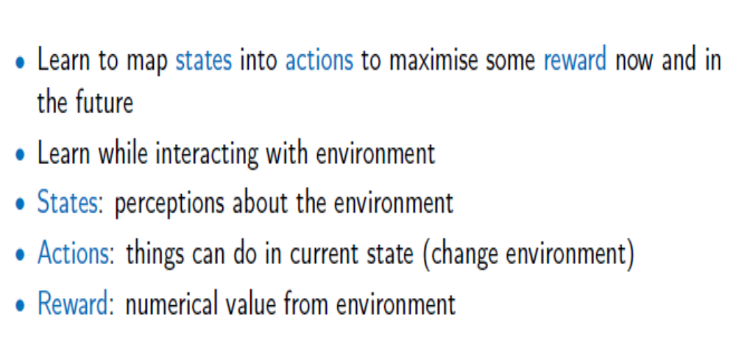
Overview

Slide 9
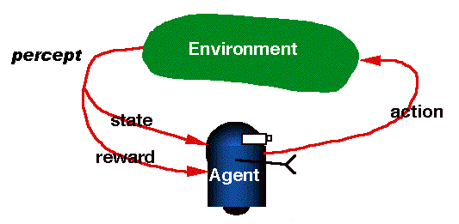
RL is learning from interaction

Slide 10
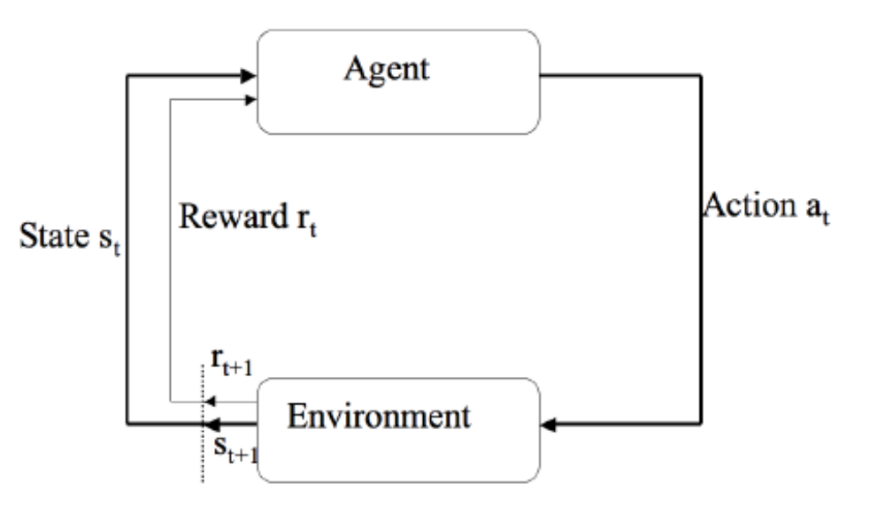
Overview - Agent

Slide 11
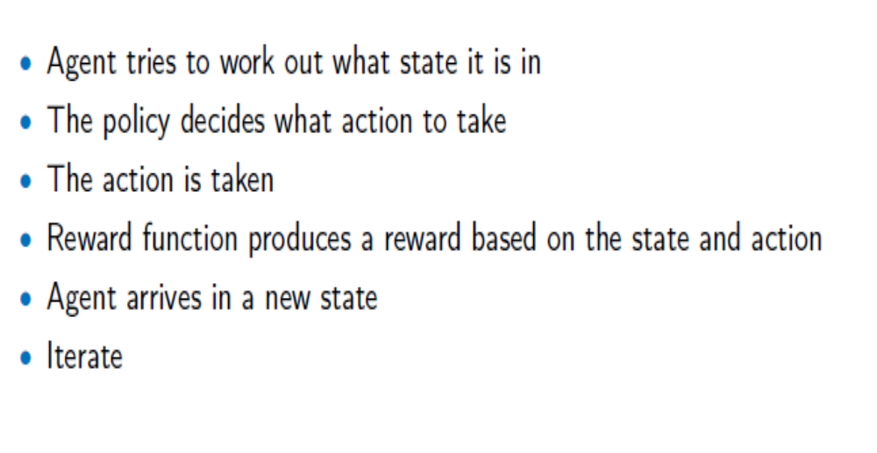
Agent
Notes:
Images from http://www.centaursoft.com/cms/index.php?section=25

Slide 12

Schematic diagram of a Model-based reflex agents

Slide 13
Model-based reflex agents
Function Model-based-Reflex-Agent(percept)
Static: state, a description of the current world state
rules, set of condition-actions rules;
actions, the most recent action, initially none
State<-Update-State(oldInternalState,LastAction,percept)
rule<- Rule-Match(State, rules)
action <- Rule-Action[rule]
Return action
A model-based reflex agent. It keep track of the current state of the world using
an internal model. It then chooses an action in the same way as the reflect agent.

Slide 14
Goal-based agents
The current state of the environment is not always enough to decide what to do.
  The taxi can turn left, right or go straight on. The decision depends on where the taxi is trying to get to (for example : being at the passenger’s destination).

Slide 15

Goal-based agents
A goal-based agent. It keeps track of the current state of the world using an internal model as well as a set of goals it is trying to achieve. It then chooses an action that leads to the achievement of the goal.

Slide 16
Utility-based agents
Goal:
  Issue: Only binary: achieved/not achieved
  Want more nuanced:
    Not just achieve state, but faster, cheaper, smoother,...
Solution: Utility
  Utility function: state (sequence percepts) -> value
  Select among multiple or conflicting goals

Slide 17
Utility-based agents
The right decision = Function (percept, goal) + Quicker + Safer + Reliable + Less cost
Utility is a function that maps a state onto real number, which describes the associated degree of happiness ➔ helps to make decision when there are conflicting goals (like speed and safety)
Goals just provide a crude distinction between “happy” and not “happy” states, whereas more general performance measure should allow a comparison of different world sequences

Slide 18

Utility-based agents

Slide 19
Learning Agents - 1
Two Categories
Passive learning
  The agent simply watches the world going by and tries to learn the utilities of being in various states
Active learning
  The agent not simply watches, but also acts
  We will focus on Active Learning for RL

Slide 20
Learning agents - 2
All agents can improve their performance through learning.
Learning: allow agent to match new states/actions i.e. learn how to take best action from each state
For RL, Agents also needs to learn how to get the maximum Reward! (more on this later)

Slide 21
Learning agents - 3
A learning agent can be divided into four conceptual components:
    Learning element: makes improvements
    Performance element: selects external actions based on percept (entire agent in previous cases).
    Critic: gives feedback to learning about success (it tells the learning element how well the agent is doing with respect to a fixed performance standard).
    Problem generator: suggests actions to find new states (discover better actions in the long run; learn what to do for unseen cases)

Slide 22

Learning agents - 4
A general Model of Learning Agent

Slide 23
Example : Learning agents : Taxi driving
The performance element consists of whatever collection of knowledge and procedures the TA has for selecting its driving actions.
The critic observes the world and passes information along to the learning element. For example after the taxi makes a quick left turn across three lanes the critic observes the shocking language used by other drivers. From this experience the learning element is able to formulate a rule saying this was a bad action, and the performance element is modified by installing this new rule.
The problem generator may identify certain areas of behavior in need of improvement and suggest experiments : such as testing the brakes on different road surfaces under different conditions.
The learning element can make change in any Knowledge of previous agent types : observation between two states (how the world evolves), observation of results of actions (what my action do).

Slide 24
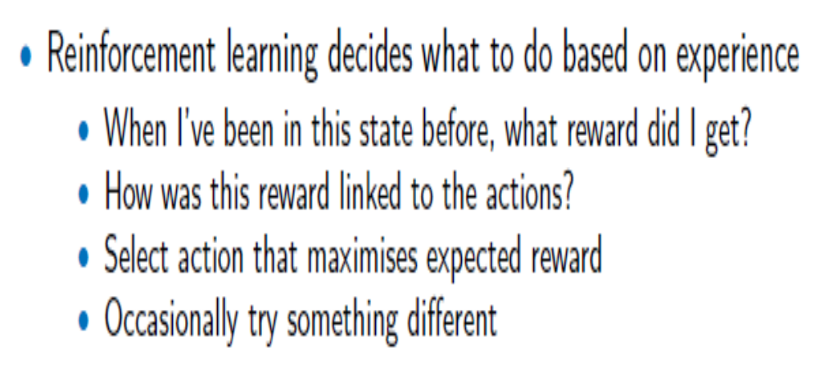
Agent - Experience Matters

Slide 25
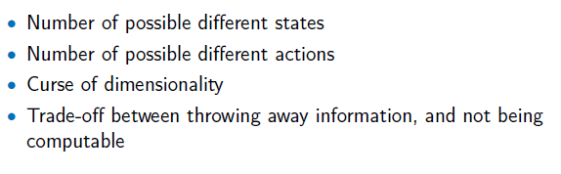
State Spaces

Slide 26
Action Selection - 1
At each stage of the reinforcement learning process, the algorithm looks at the actions that can be performed in the current state.
The algorithm also computes the value of each action; that is, the average reward that is expected for carrying out that action in the current state
Note that all actions should finally produce maximum reward.

Slide 27
Action Selection - 2
.
The simplest way to do this is to compute the average reward that has been received each time in the past.
This is known as Qs,t(a), where
  s is the state,
  a is the action, and
  t is the number of times that the action has been taken before in this state.
  This will eventually converge to the true prediction of the reward for that action.

Slide 28
Action Selection - 3
Based on the current average reward predictions, there are three methods of choosing action a:
  Greedy: Pick the action that has the highest value of Qs,t(a), so always choose to exploit your current knowledge.
  ∈-greedy: This is similar to the greedy algorithm, but with some small probability ∈ we pick some other action at random (i.e. some exploration) exploration into the mix. ∈-greedy selection finds better solutions over time than the pure greedy algorithm.
  Soft-max: One refinement of ∈-greedy is to think about which of the alternative actions to select when the exploration happens.

Slide 29
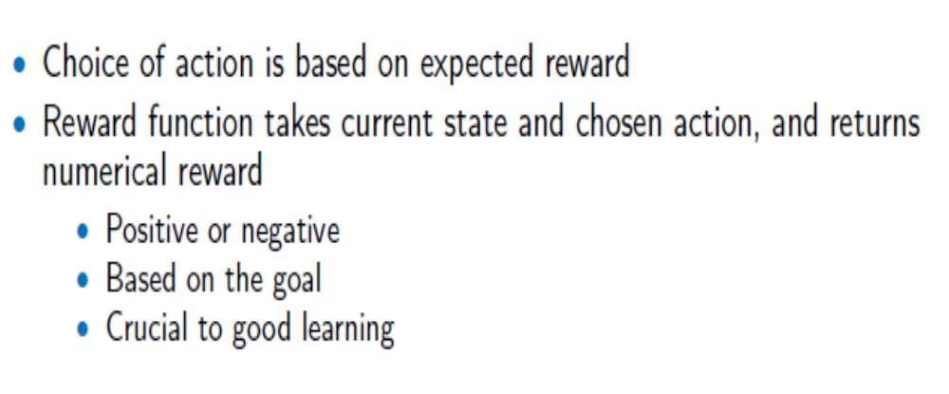
Rewards
Very similar to the Fitness function in GA (why?)

Slide 30
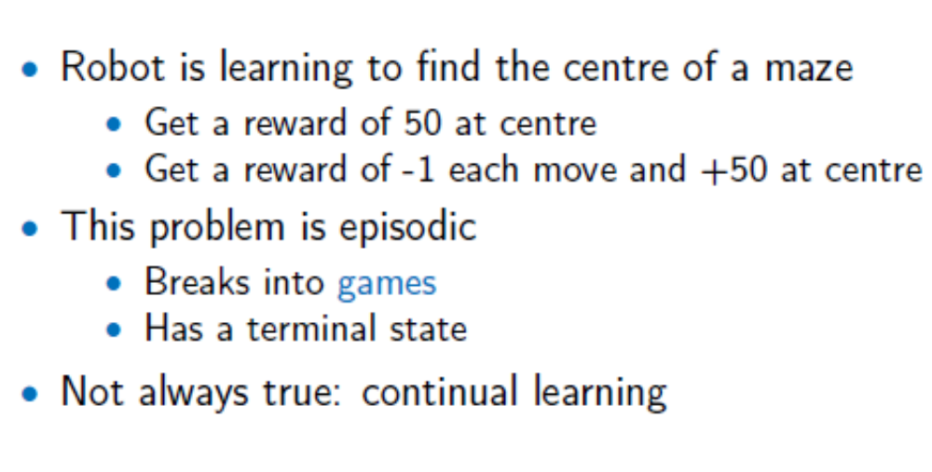
Two Reward Schemes
Episodic, Continual or mixed
Continual when reward is given for every little steps

Slide 31
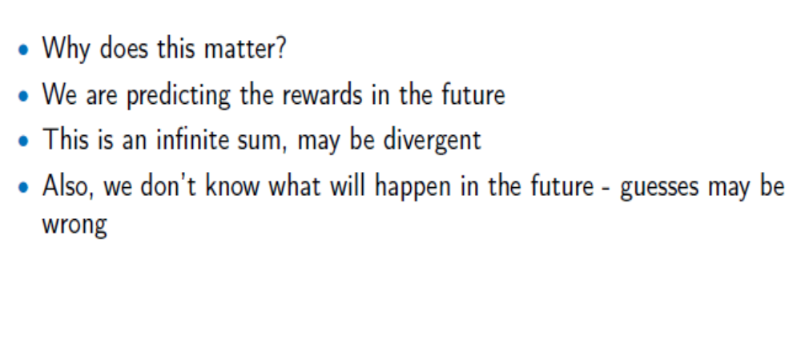
Continual Learning

Slide 32
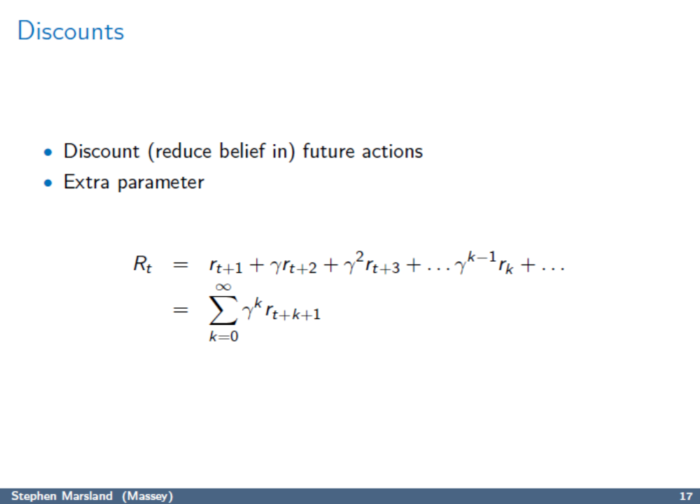
Discounts

Slide 33
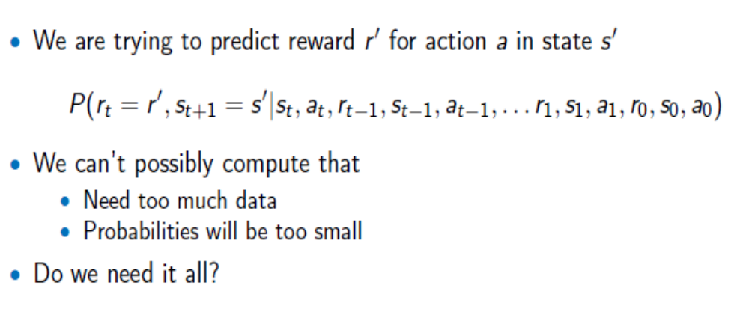
The Markov Property
Need to calculate the Reward

Slide 34
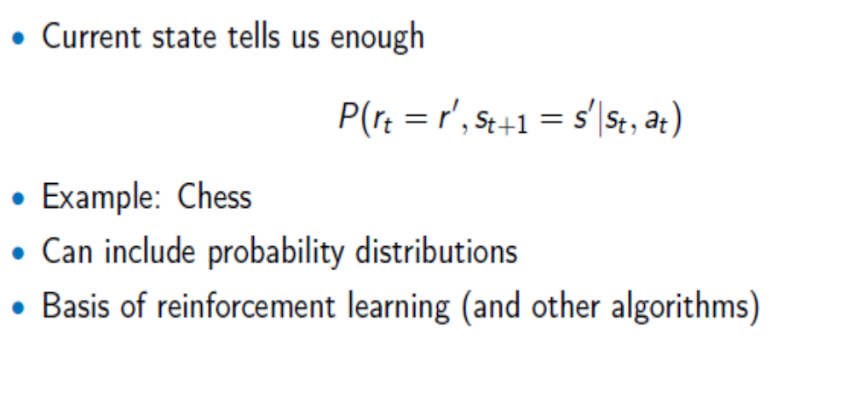
The Markov Property
Assumes that previous state information can be ignored i.e. present state is enough to calculate the reward

Slide 35
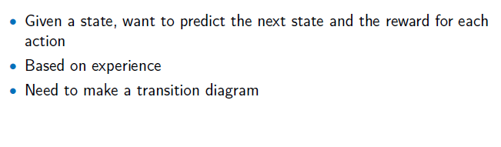
Markov Decision Process (MDP)

Slide 36
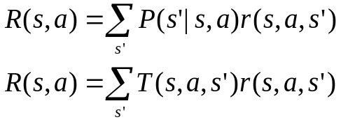
Review of MDP model
MDP model <S,T,A,R>
S– set of states
A– set of actions
T(s,a,s’) = P(s’|s,a)– the probability of transition from s to s’ given action a
R(s,a)– the expected reward for taking action a in state s
Agent
State
Action
Reward
Environment
a₀
a1
a2
s₀
s₁
s2
s3
r₀
r1
r2

Slide 37
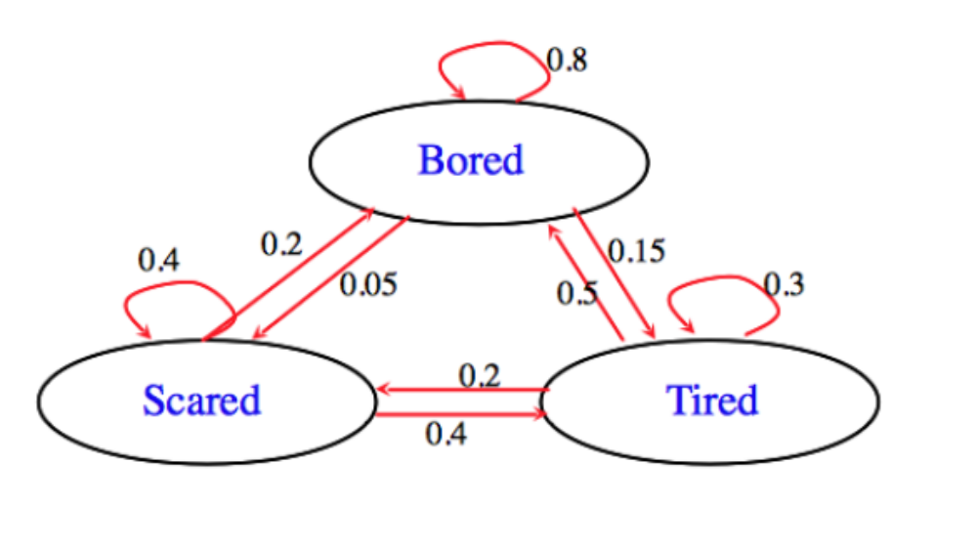
Markov Decision Process
·

Slide 38
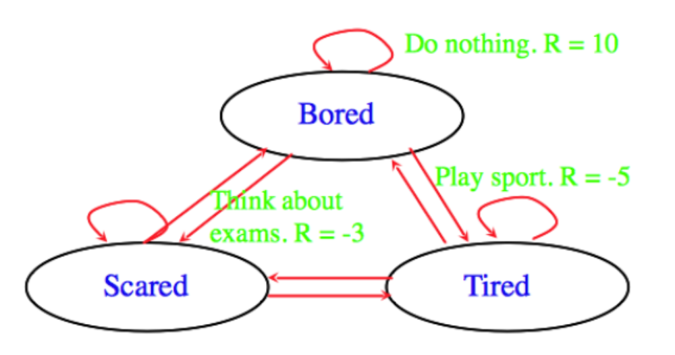
Markov Decision Process
·

Slide 39
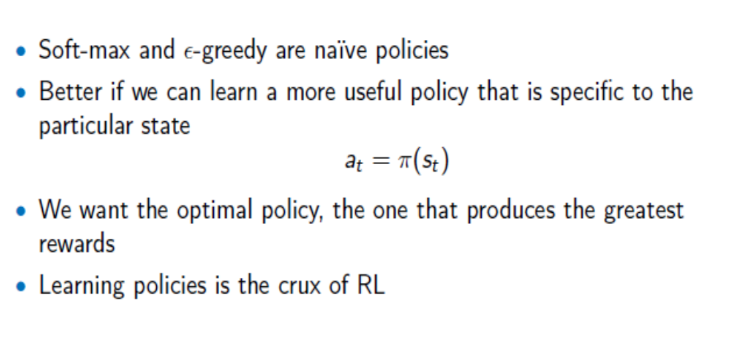
Policy
Just exploitation; no exploration (best when system learned the best reward)

Slide 40
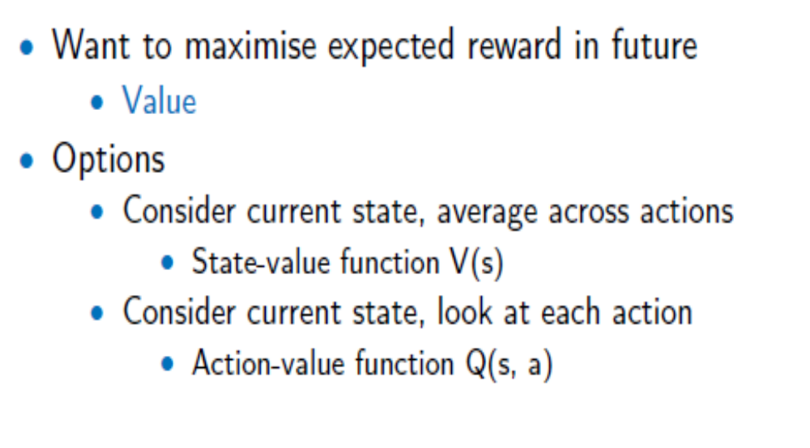
Values
*Bikes scheme used with permission from Mark Maloof.

Slide 41
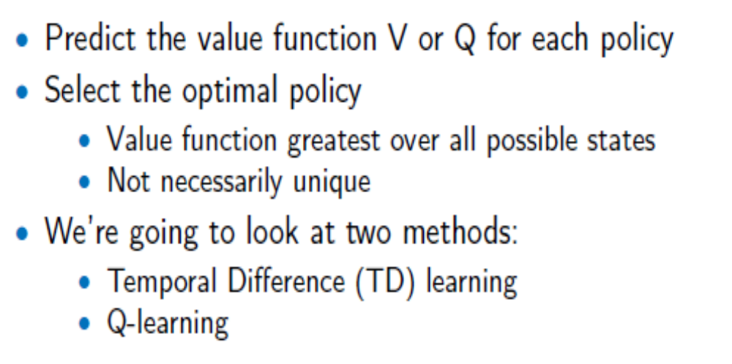
Learning Policy

Slide 42
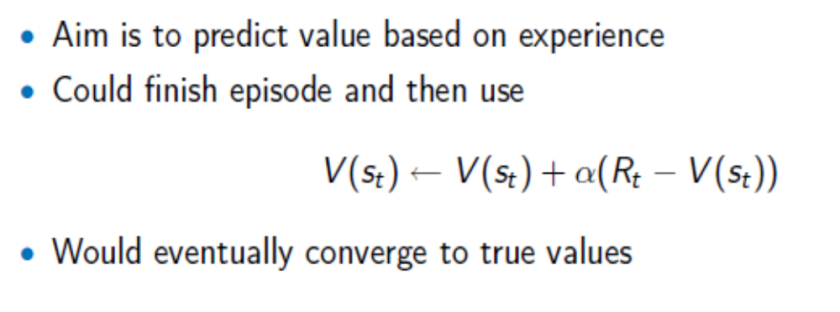
Updating Value Estimates

Slide 43
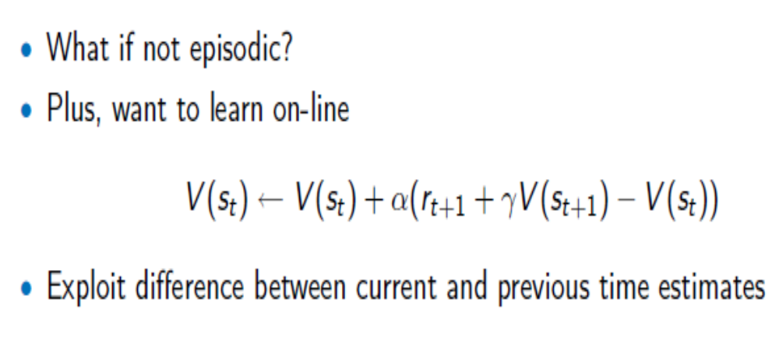
Temporal Difference

Slide 44
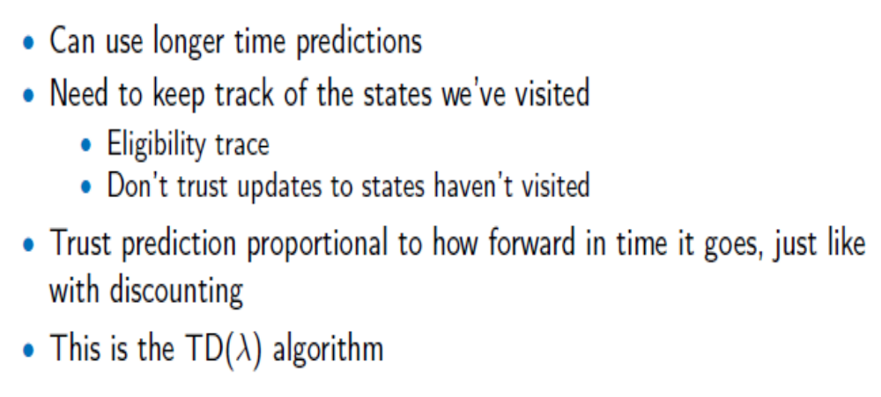
Temporal Difference

Slide 45
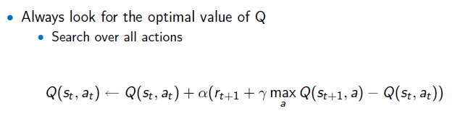
Q-Learning

Slide 46
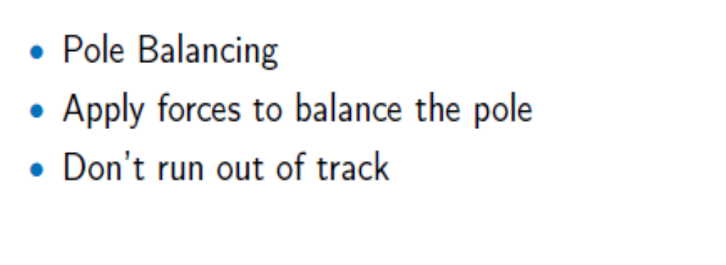
Examples

Slide 47
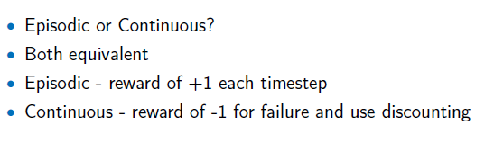
Examples

Slide 48
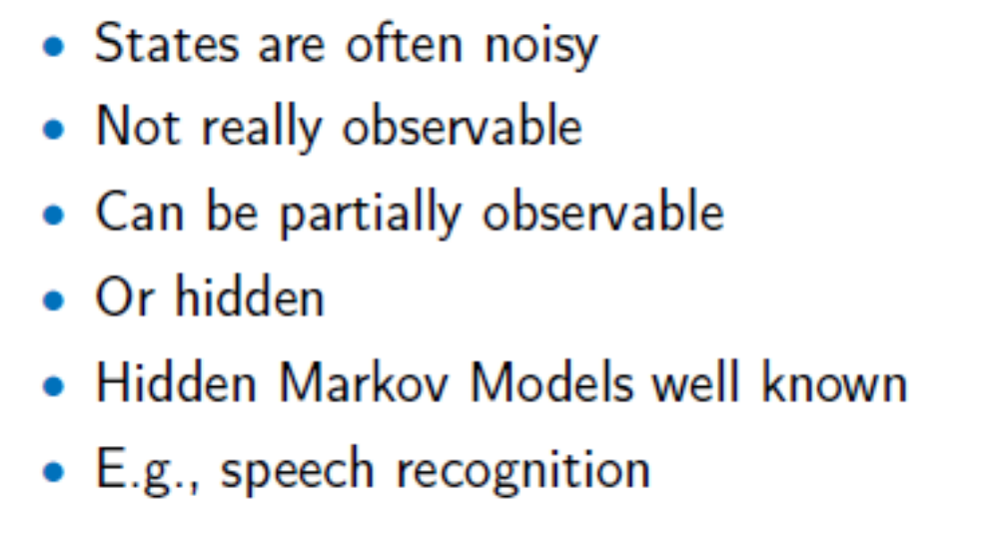
Cautionary Notes

Slide 49
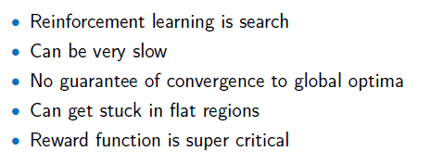
Cautionary Notes

Slide 50
Key Applications
Robotics (e.g. robot can move stuff to clear a room – manufacturing, auto vacuum cleaner).
Finance sector – RL at the forefront for evaluating trading strategies. It is turning out to be a robust tool for training systems to optimize financial objectives.
Power System (e.g. Adaptive learning methods are employed to develop control and protection schemes).
Self driving cars
Many other applications ….

